Slide 1
專題研究進度報告
指導教授：盧奕璋教授
學生：電機三 B05901064 林承德
日期：2019/06/27

Slide 2
User Guide
Start
A:00, C:01, G:10, T:11
Length of S is unlimited
Length of T ≤ 7168
Match(one of parameters) ≤ 15
Use 256words x 1024 addr sram (32 8x1024 srams)
Set sequence T
Sequence T
Compute
IDLE
Sequence S, parameter
Result

Slide 3
Input Type
Input [127:0] i_s
64 DNA of sequence s, i_s[127:126] represents the former DNA.
Input [6:0] i_s_valid
7’d0 means not valid, 7’b1111111 means there are DNA after i_s.
Other means only the value of i_s are valid.
Input [17:0] i_t
i_t[17] : valid or not
i_t[16:14] :
3’d0 means there are DNAs after i_t
other means only the value of i_t are valud
i_t[13:0] : 7 DNA of sequence, i_t[13:12] represents the former DNA

Slide 4
Recap.
Data Processor傳資料給PE Controller時
Data Processor要等到Controller說下次要不要S才能輸出有效的資料
Controller要確定Data Processor這次有沒有給資料，才能知道下次要甚麼資料
我想要讓Data Processor在每個clk都能輸出有效資料
結論：Controller給Data Processor是combinational output(Path 過長)
Data Processor
PE Controller
CL
o_s_valid
PE_enable
CL
Need_s
PE Array

Slide 5
Improve
由Data Processor 自行計算要傳甚麼資料給PE controller
第一個 PE element的控制訊號也由Data Processor給
PE Controller 藉由Data Processor給出的訊號算出之後其他element的控制訊號
Data Processor
PE Controller
CL
o_enable_0
PE_enable
o_s
PE Array

Slide 6

Gate Level
Critical Path : PE element
cycle(ns) | area | AT value | power(mW) | ratio(16384x1024)
10 | 3084412 | 30844123.61 | 32.1701 | 80.60024
8 | 3143204 | 25145628.05 | 40.907 | 100.7503
6 | 3270118 | 19620708.62 | 57.5923 | 134.3337333
Computer : Ubuntu 16.04
with four Intel I5-6300HQ @ 2.30GHz
Credit :

Slide 7
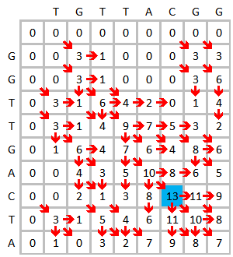



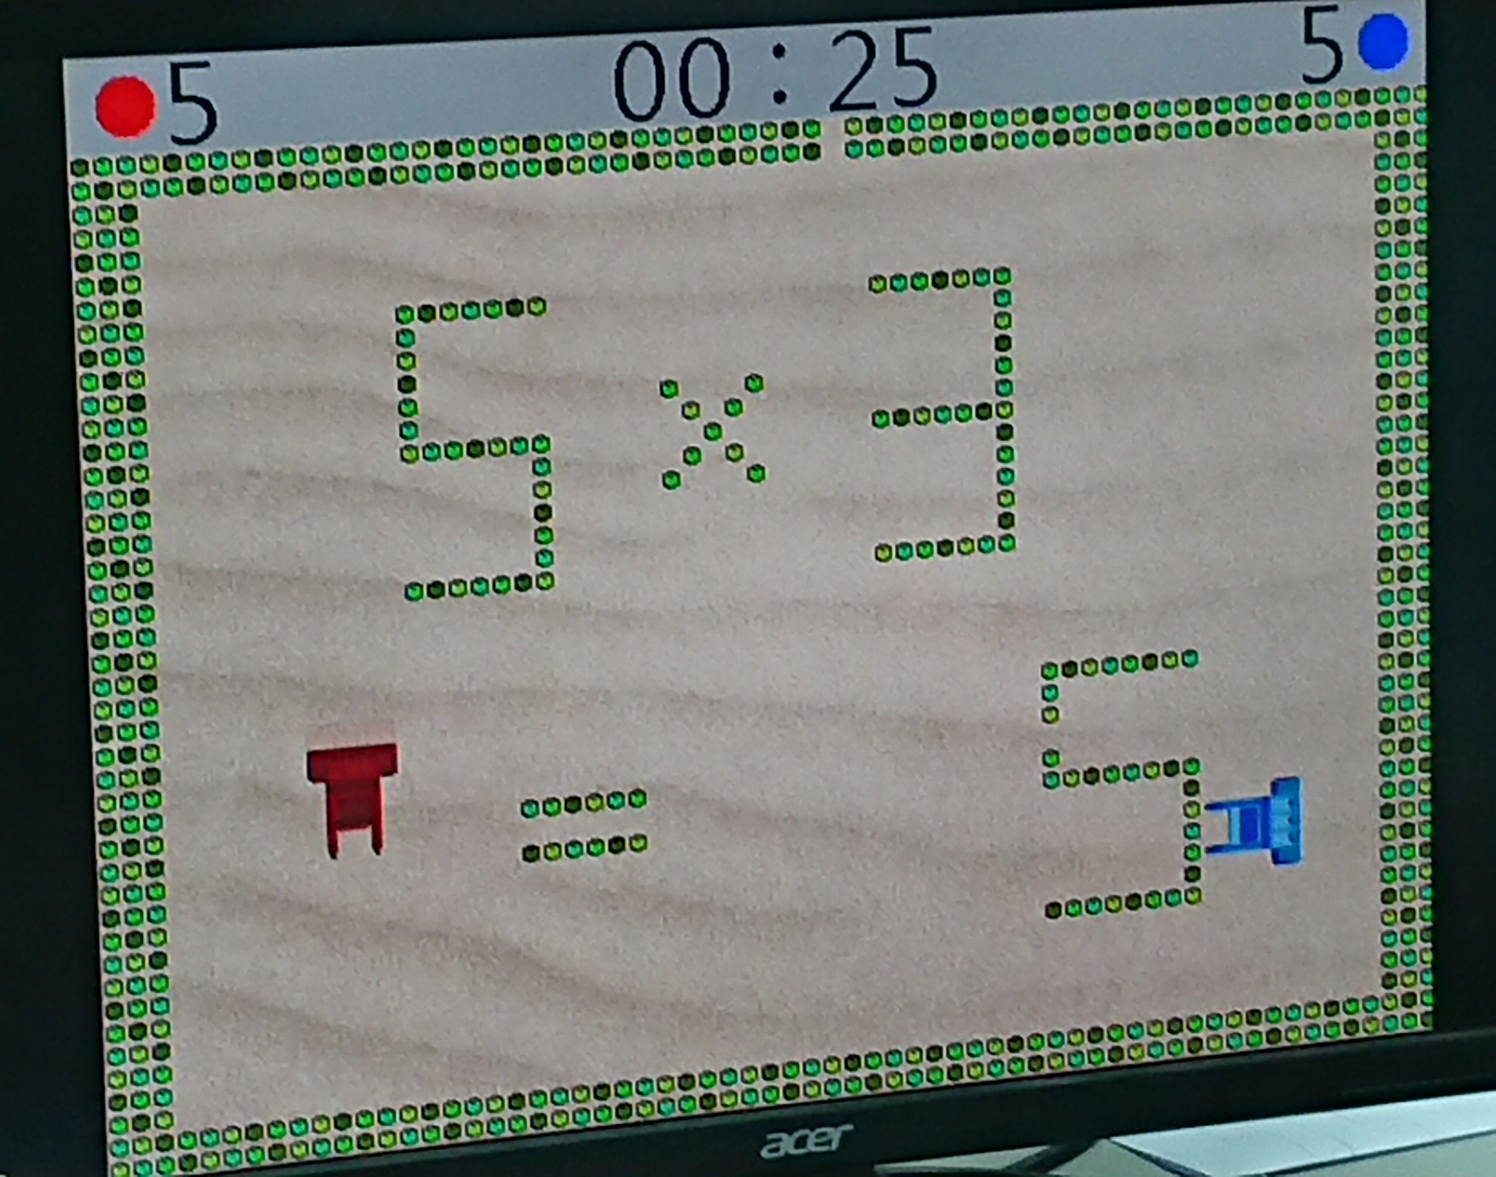

Slide 8
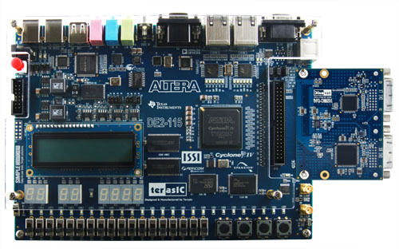
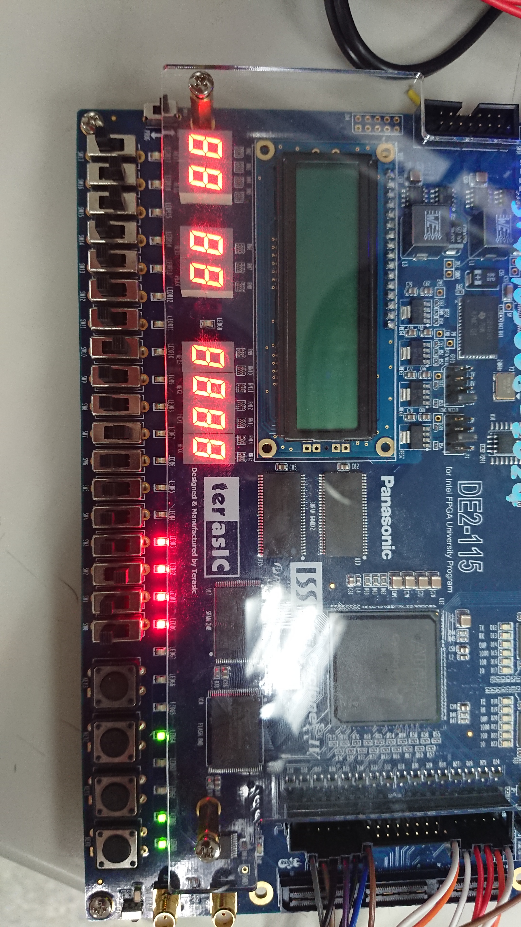
FPGA
Result
LED
State
Start
Set
T
Rst
Match
Mismatch
Alpha
Beta

Slide 9
FPGA
FPGAWrapper
Store the sequences on FPGA to give data to origin top module.
Aware of the delay of input buffer.
SystemVerilog v.s. Verilog
Give a name to for loop.
Can’t use sram_1024x8_t13.v
Use simple RTL sram.

Slide 10
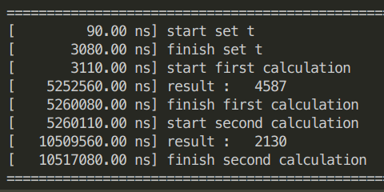
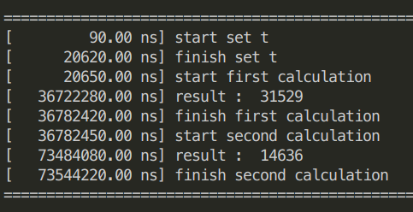
FPGA
16384 x 1024
S | T | set cycle | valid cycle | busy cycle
80 | 80 | 1023 | 203 | 203
256 | 256 | 1023 | 1142 | 1142
512 | 512 | 1023 | 2292 | 2292
1024 | 1024 | 1023 | 16847 | 16847
2048 | 1024 | 1023 | 33247 | 33247
4096 | 1024 | 1023 | 66047 | 66047
8192 | 1024 | 1023 | 131647 | 131647
16384 | 1024 | 1023 | 262847 | 262847
16384 | 7168 | 1023 | 1834497 | 1834497
16384 x 7168

Slide 11
FPGA
Clock cycle = 20ns
Computer : Ubuntu 16.04
with four Intel I5-6300HQ @ 2.30GHz
S | T | software (s) | hardware(s) | ratio
80 | 80 | 0.002 | 0.00000862 | 232.0186
256 | 256 | 0.007 | 0.00004668 | 149.9572
512 | 512 | 0.013 | 0.0001753 | 74.15859
1024 | 1024 | 0.036 | 0.00067708 | 53.16949
2048 | 1024 | 0.064 | 0.00133308 | 48.00912
4096 | 1024 | 0.12 | 0.00264508 | 45.36725
8192 | 1024 | 0.223 | 0.00526908 | 42.32238
16384 | 1024 | 0.421 | 0.01051708 | 40.03012
16384 | 7168 | 2.726 | 0.07354422 | 37.06614

Slide 12
Summary
RTL & Gate-level finish
Use FPGA to implement the algorithm
Still not finish when sequence T is little
Think carefully before implement on hardware
Problem of the data transmission.
It seems that I can reduce the number of SRAM…

